Slide 1
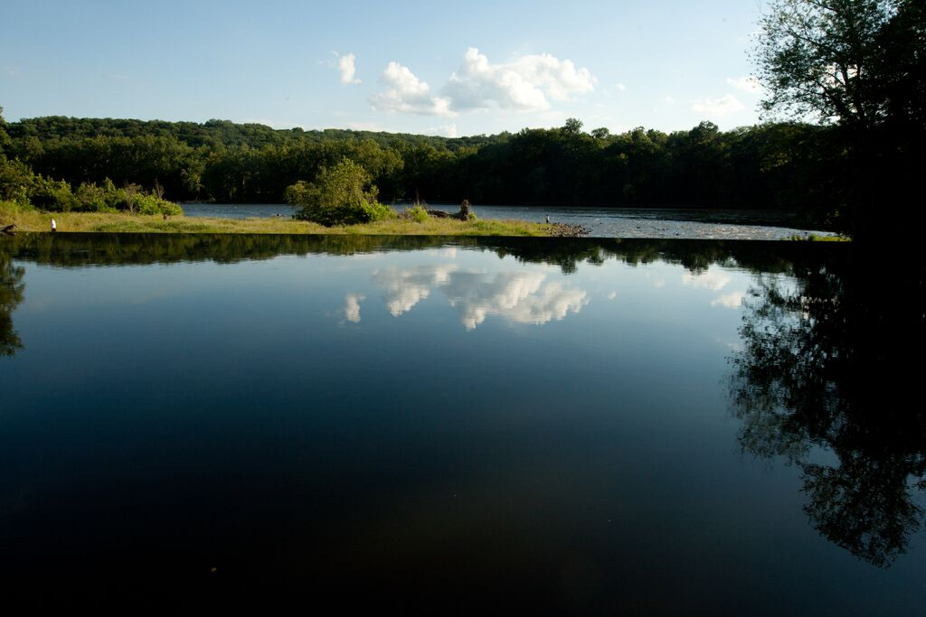
Lower Delaware Wild & Scenic River
Presented by the Lower Delaware Wild & Scenic River Management Council Steering Committee
Photo: Bill Brokaw

Slide 2
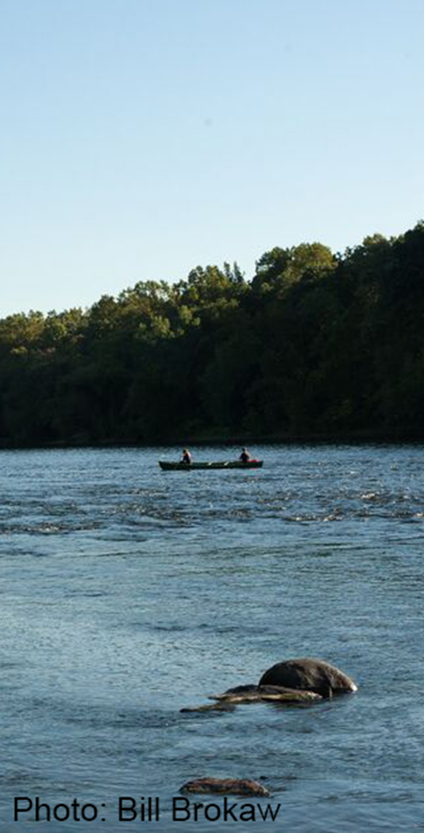
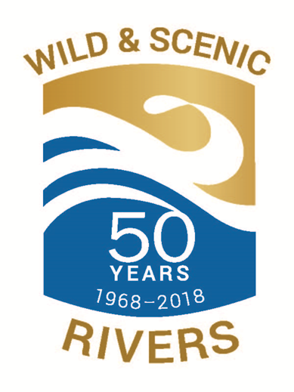
National Wild & Scenic Rivers Act
Created by an act of Congress in 1968
“to preserve free-flowing rivers with outstanding natural, cultural & recreational values for the enjoyment of present and future generations”
Managing agencies:
Bureau of Land Management
National Park Service
U.S. Fish and Wildlife Service
U.S. Forest Service
Rivers designated as wild, scenic or recreational

Slide 3
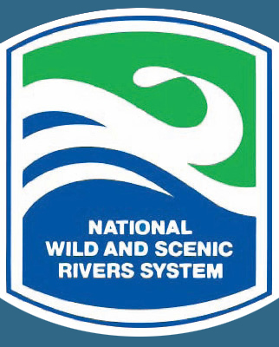
National Wild & Scenic Rivers System
What Does it Do?
Prohibits dams and large-scale federal projects that alter free-flowing condition, water quality, or Outstanding Resource Values (ORV)
Involves all stakeholders in planning process
Coordinates agencies at local, state and federal levels
Provides incentive grants to fund river maintenance projects
Increases public awareness and river appreciation

Slide 4
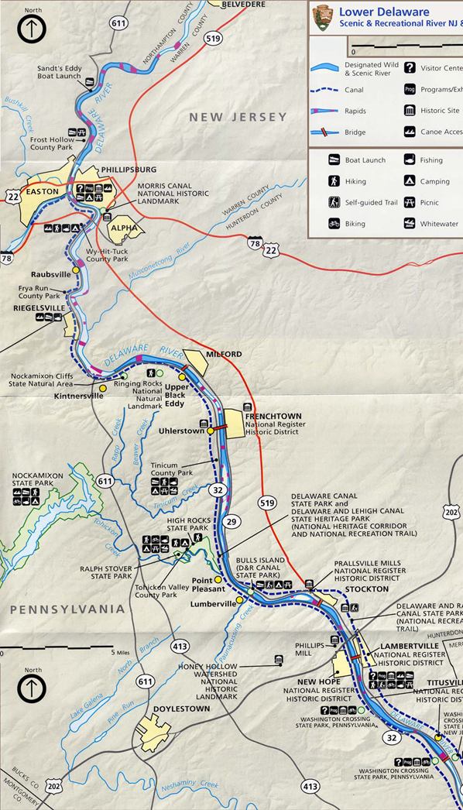
Lower Delaware Wild & Scenic River
Designated in 2000 as a Partnership River
67.3 miles of scenic & recreational designation
Scenic = 25.4 miles; Recreational = 41.9 miles
Portions of four tributaries also designated:
Tinicum Creek
Tohickon Creek
Paunacussing Creek
Musconetcong River (2006)

Slide 5
Lower Delaware Wild & Scenic River
Partnership River – what does that mean?
No federal ownership or management
Local council guides the management
Land use locally controlled
NPS role limited and specified in the plan
River management plan locally developed
Plan implementation shared among partners
No NPS rangers or traditional superintendent
PARTNERSHIP RIVERS
Great Egg River (NJ), 1992
Maurice River, (NJ) 1993
Farmington (CT), 1994
Lamprey (NH), 1996/2000
SuAsCo (MA),1999
White Clay (DE/PA), 2000
Lower Delaware (PA/NJ),2000
Wekiva(FL), 2000
Musconetcong (NJ), 2006
Eightmile (CT), 2008
Taunton (MA), 2009
Missisquio (VT), 2014

Slide 6
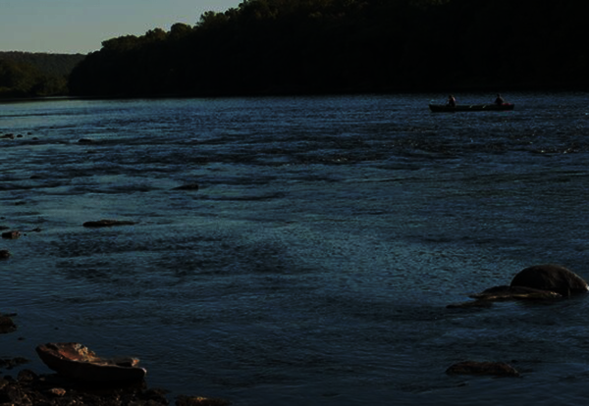
Lower Delaware Wild & Scenic River
Designated Areas / Potential Designated areas*
Pennsylvania
New Jersey
Northampton County
City of Easton * Forks Twp. Lower Mt. Bethel Portland Borough * Upper Mt. Bethel Williams Twp. *
Bucks County
Bedminster Twp Bridgeton Twp. Durham Twp.* New Hope Borough Nockamixon Twp. Plumstead Twp. Riegelsville Borough Solebury Twp. Springfield Twp. Tinicum Twp. Upper Makefield Twp.
Warren County
Belvidere Town * Harmony Twp. Knowlton Twp. Lopatcong Twp. Pohatcong Twp. * Town of Phillipsburg * White Twp. *
Hunterdon County
Alexandria Twp. City of Lambertville Delaware Twp. Frenchtown Borough Holland Twp. Kingwood Twp. Milford Borough Stockton Borough West Amwell Twp.
Mercer County
Hopewell Twp.
Photo: Bill Brokaw

Slide 7
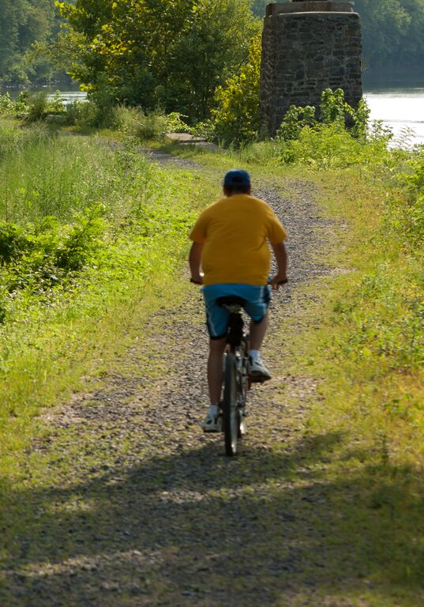
Lower Delaware Wild & Scenic River
Management Council
Important Functions:
Provides forum for river-related issues
Monitors watershed activities and proposals
Promotes enhancement/restoration of the watershed
Performs watershed stewardship education and outreach
Reviews and selects incentive grants
Advises NPS on its budget allocations
Photo: Bill Brokaw

Slide 8
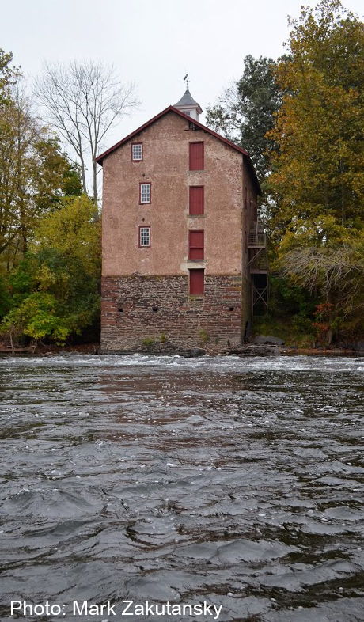
Lower Delaware Wild & Scenic River
Management Council
Primary Function:
Support
Coordinate
Facilitate
Implement
The Management Plan

Slide 9
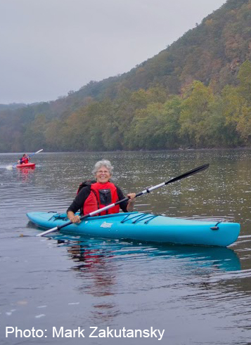
Lower Delaware Wild & Scenic River
Management Plan
Key Goals:
Maintain/improve water quality
Preserve and protect natural resources
Preserve and protect historic & cultural resources
Encourage recreational use of the river corridor
Encourage economic development
Preserve open space
Educate and inform citizens and landowners

Slide 10
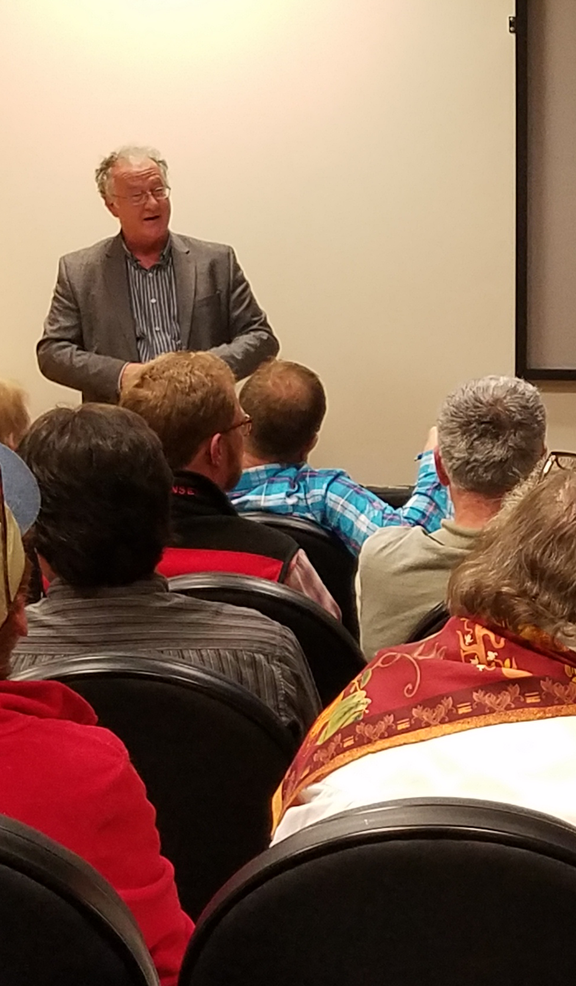
Lower Delaware Wild & Scenic River
Management Council
Benefits of Participation:
Learn about what is happening on and along the river
Coordinate efforts with other partners
Land and resource conservation
Potential environmental threats from energy extraction and installation of large-scale utilities
Local land use ordinances and decisions that impact the river
Fund your projects through our small grants program

Slide 11
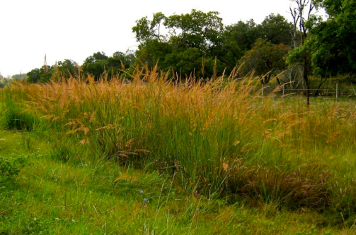
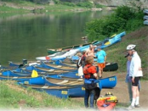
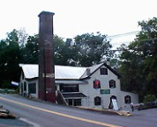
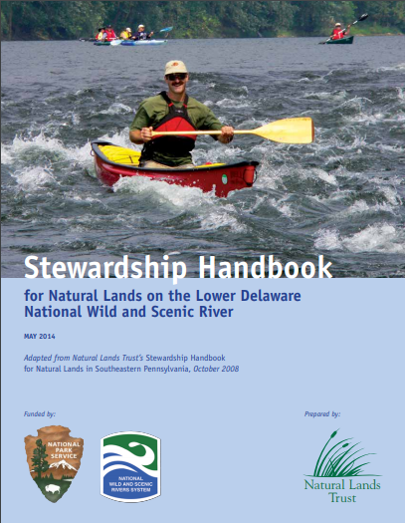
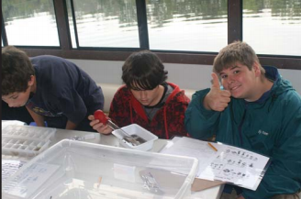
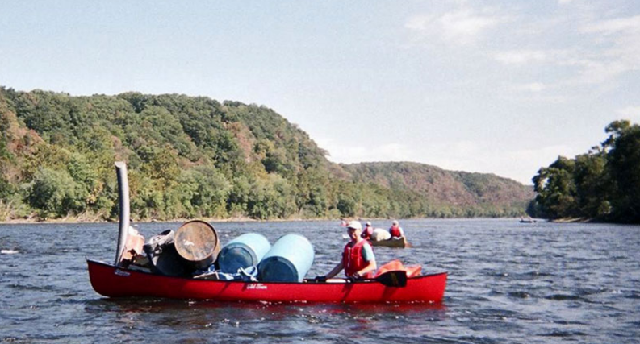
Lower Delaware Wild & Scenic River
Between 2000 and 2014, the NPS provided more than $1.1 million for more than 60 projects throughout the LDWS corridor:
Recreational Opportunities
Restoration Projects
River Cleanups
Historic Resource Surveys
Education

Slide 12
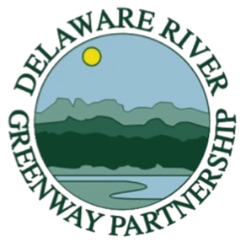
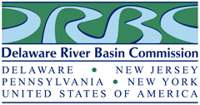
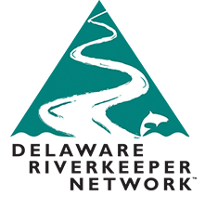
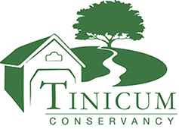
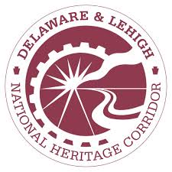
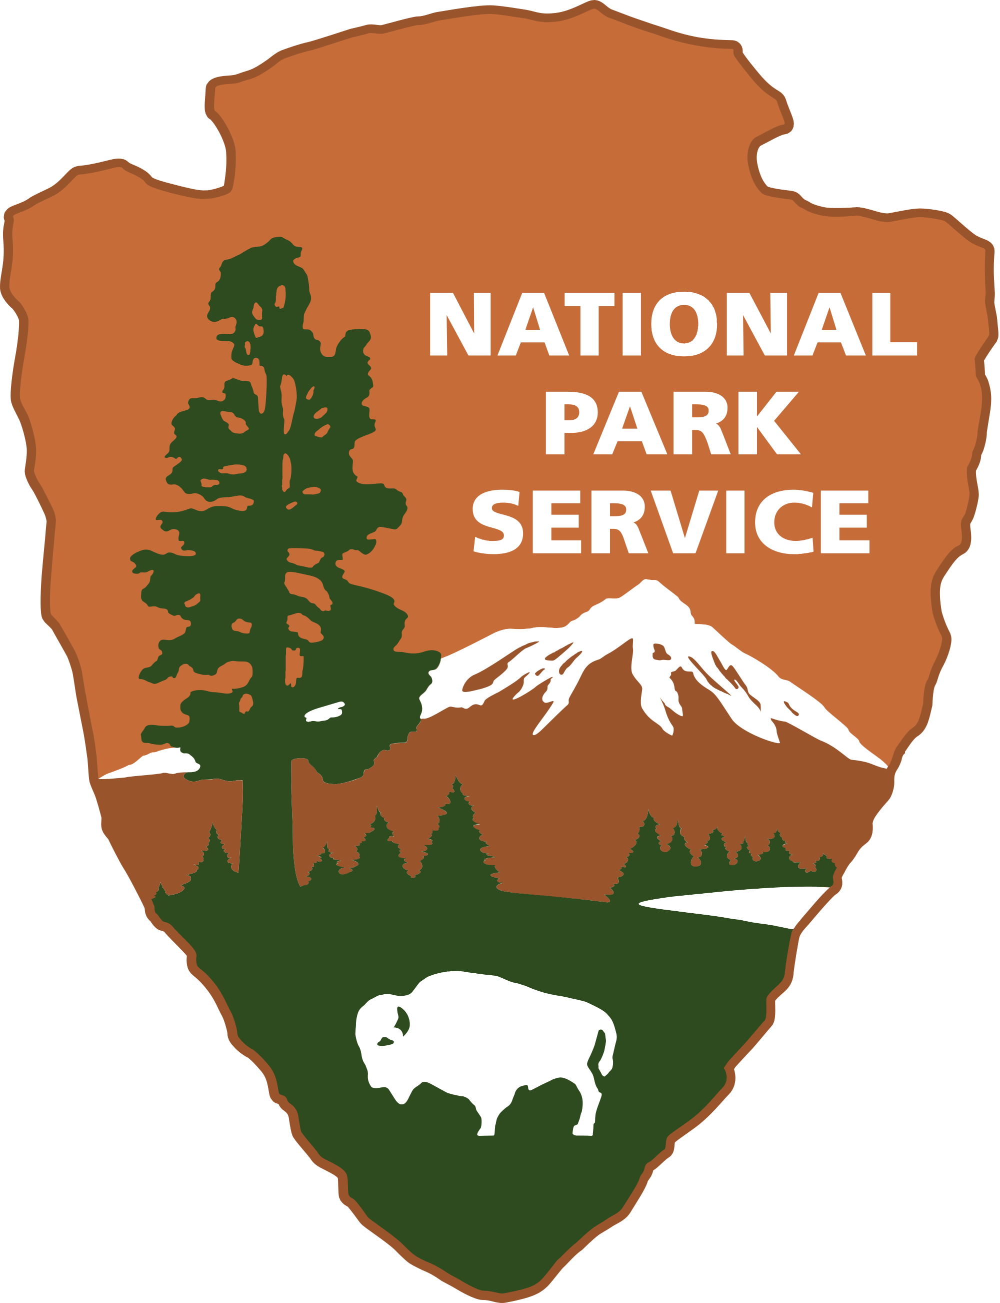
Lower Delaware Wild & Scenic River
Municipalities & Partners
In PA
Bedminster Twp. Bridgeton Twp. Forks Twp. Lower Mt. Bethel New Hope Borough Nockamixon Twp. Plumstead Twp. Riegelsville Borough Solebury Twp. Springfield Twp. Tinicum Twp. Upper Makefield Twp.
In NJ
Alexandria Twp. City of Lambertville Delaware Twp. Frenchtown Borough Harmony Twp. Holland Twp. Hopewell Twp. Kingwood Twp. Knowlton Twp. Lopatcong Twp. Milford Borough Stockton Borough West Amwell Twp.
Paunacussing
Watershed Association
Martins-Jacoby
Watershed Association
Tinicum Creek
Watershed Association

Slide 13
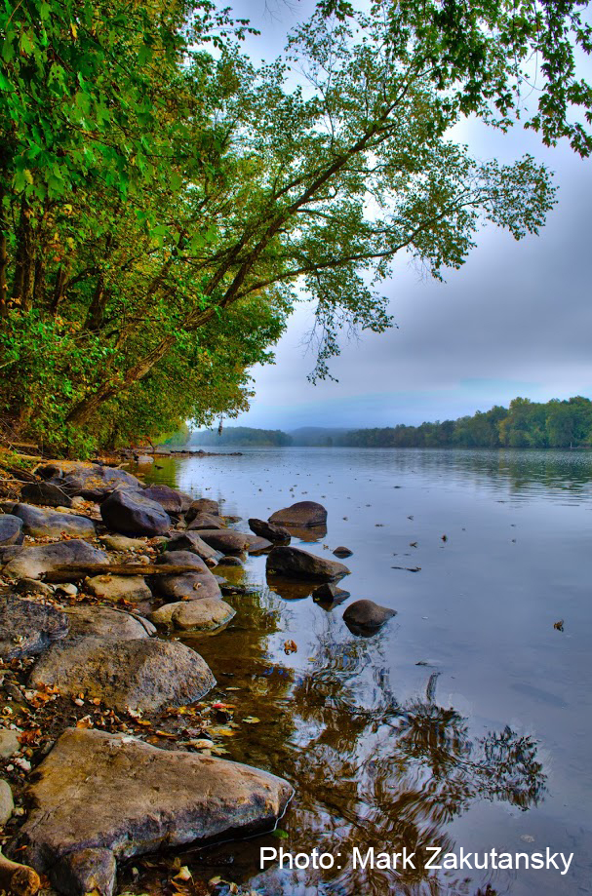
Lower Delaware Wild & Scenic River Municipalities & Partners
What you can do…
Enact local initiatives to preserve and protect the Delaware River Basin in your municipalities
Support LDWS initiatives – have a representative attend the quarterly meetings
Educate your municipalities about the LDWS and encourage participation

